Slide 1


Exploring the World University Rankings 2024
This presentation will dive into the latest QS World University Rankings, analyzing the data to uncover key insights and trends. Through a series of visually engaging charts and diagrams, we will explore the geography, performance, and influential factors that shape the global higher education landscape.

Slide 2
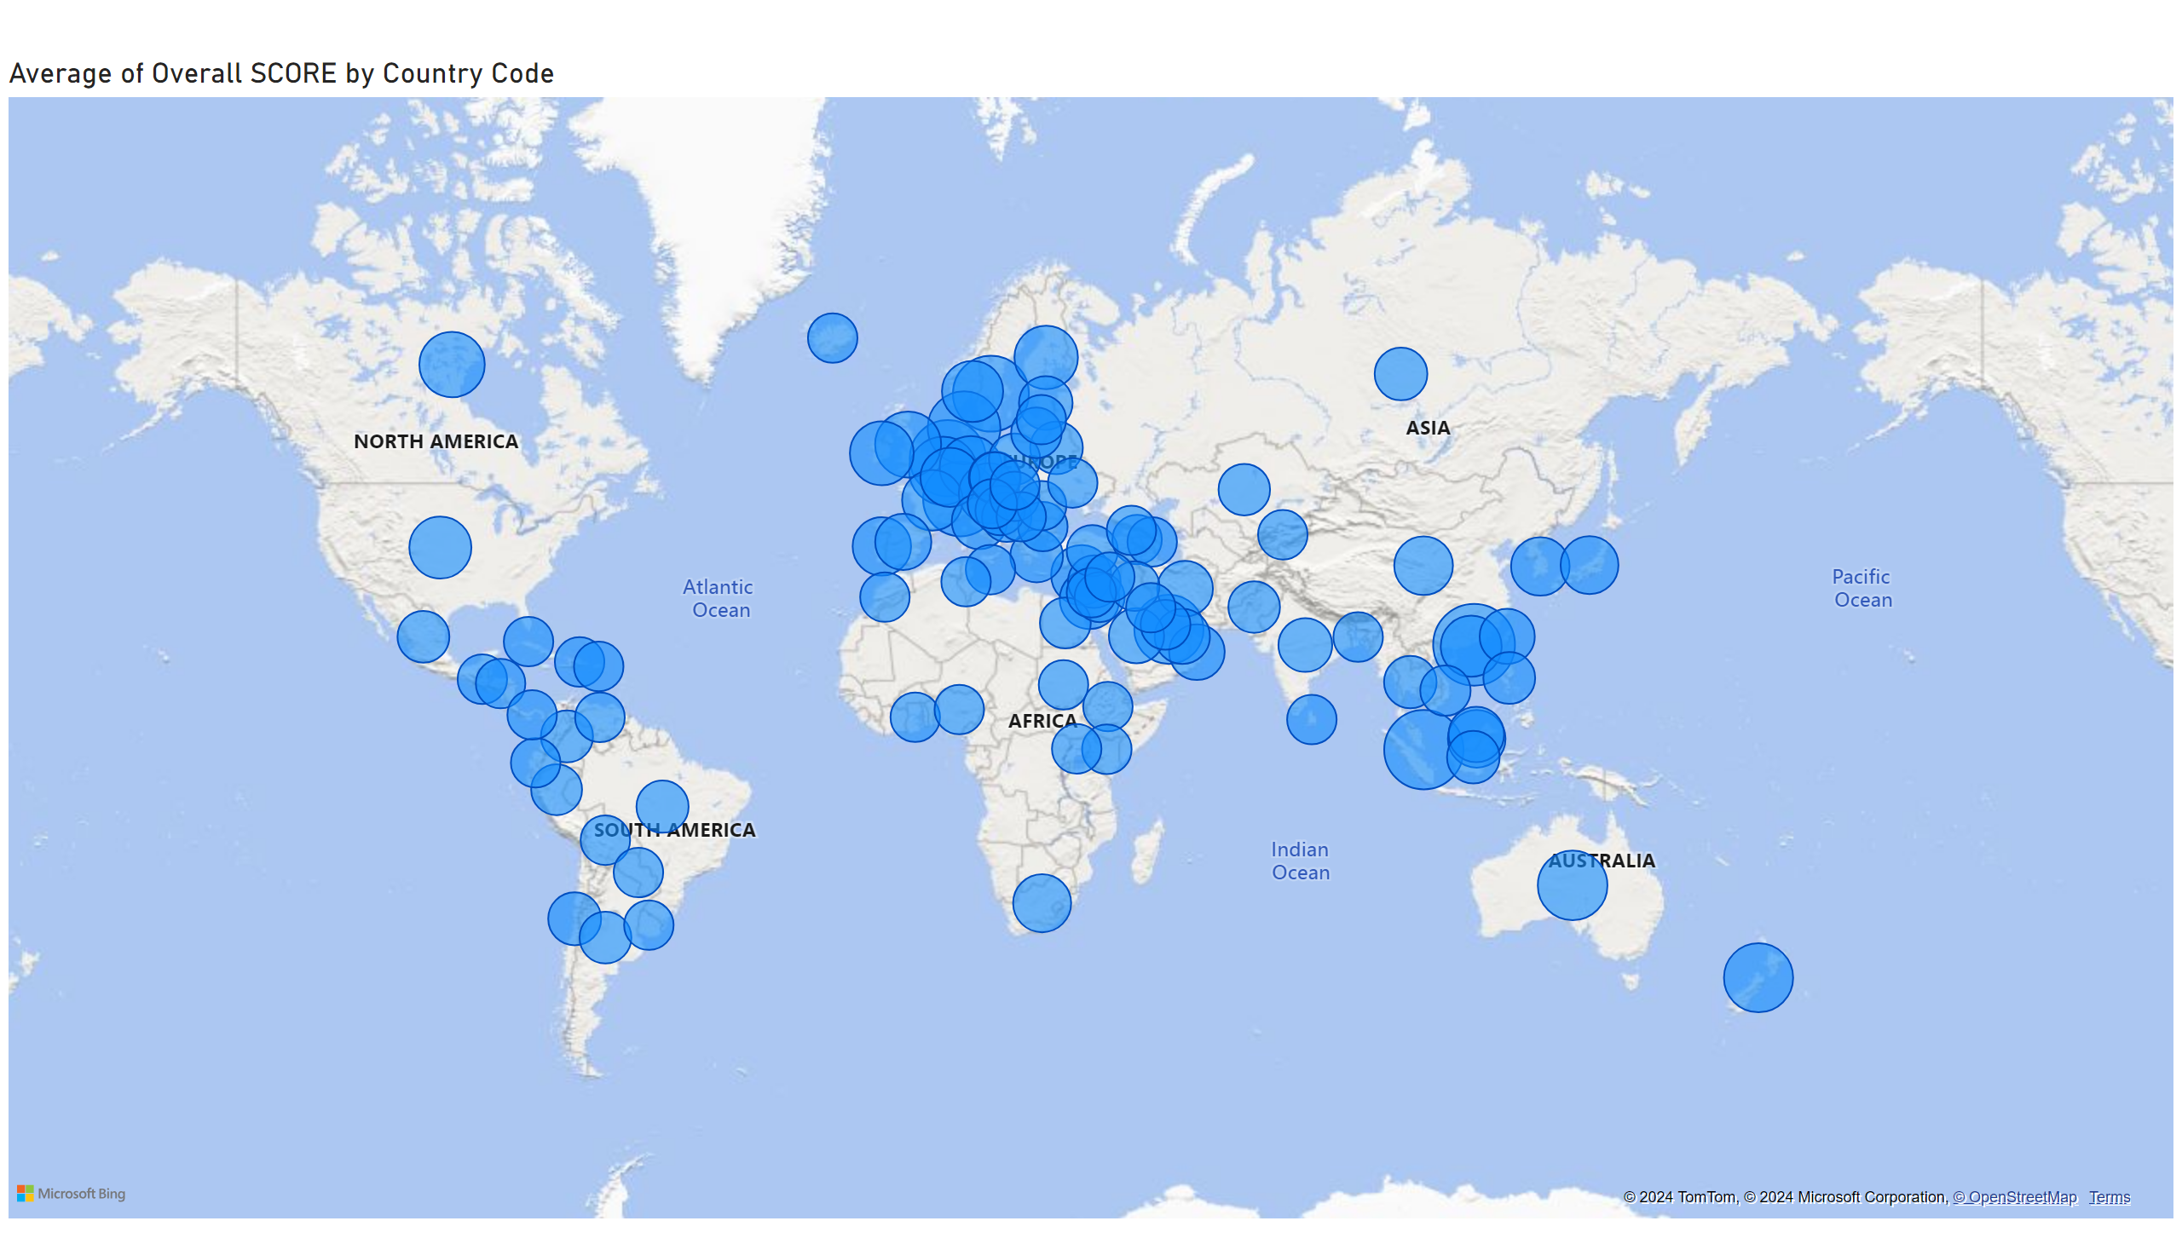
This graph shows average of overall score per country in Geographical format
Size of bubble is indicator of average score

Slide 3
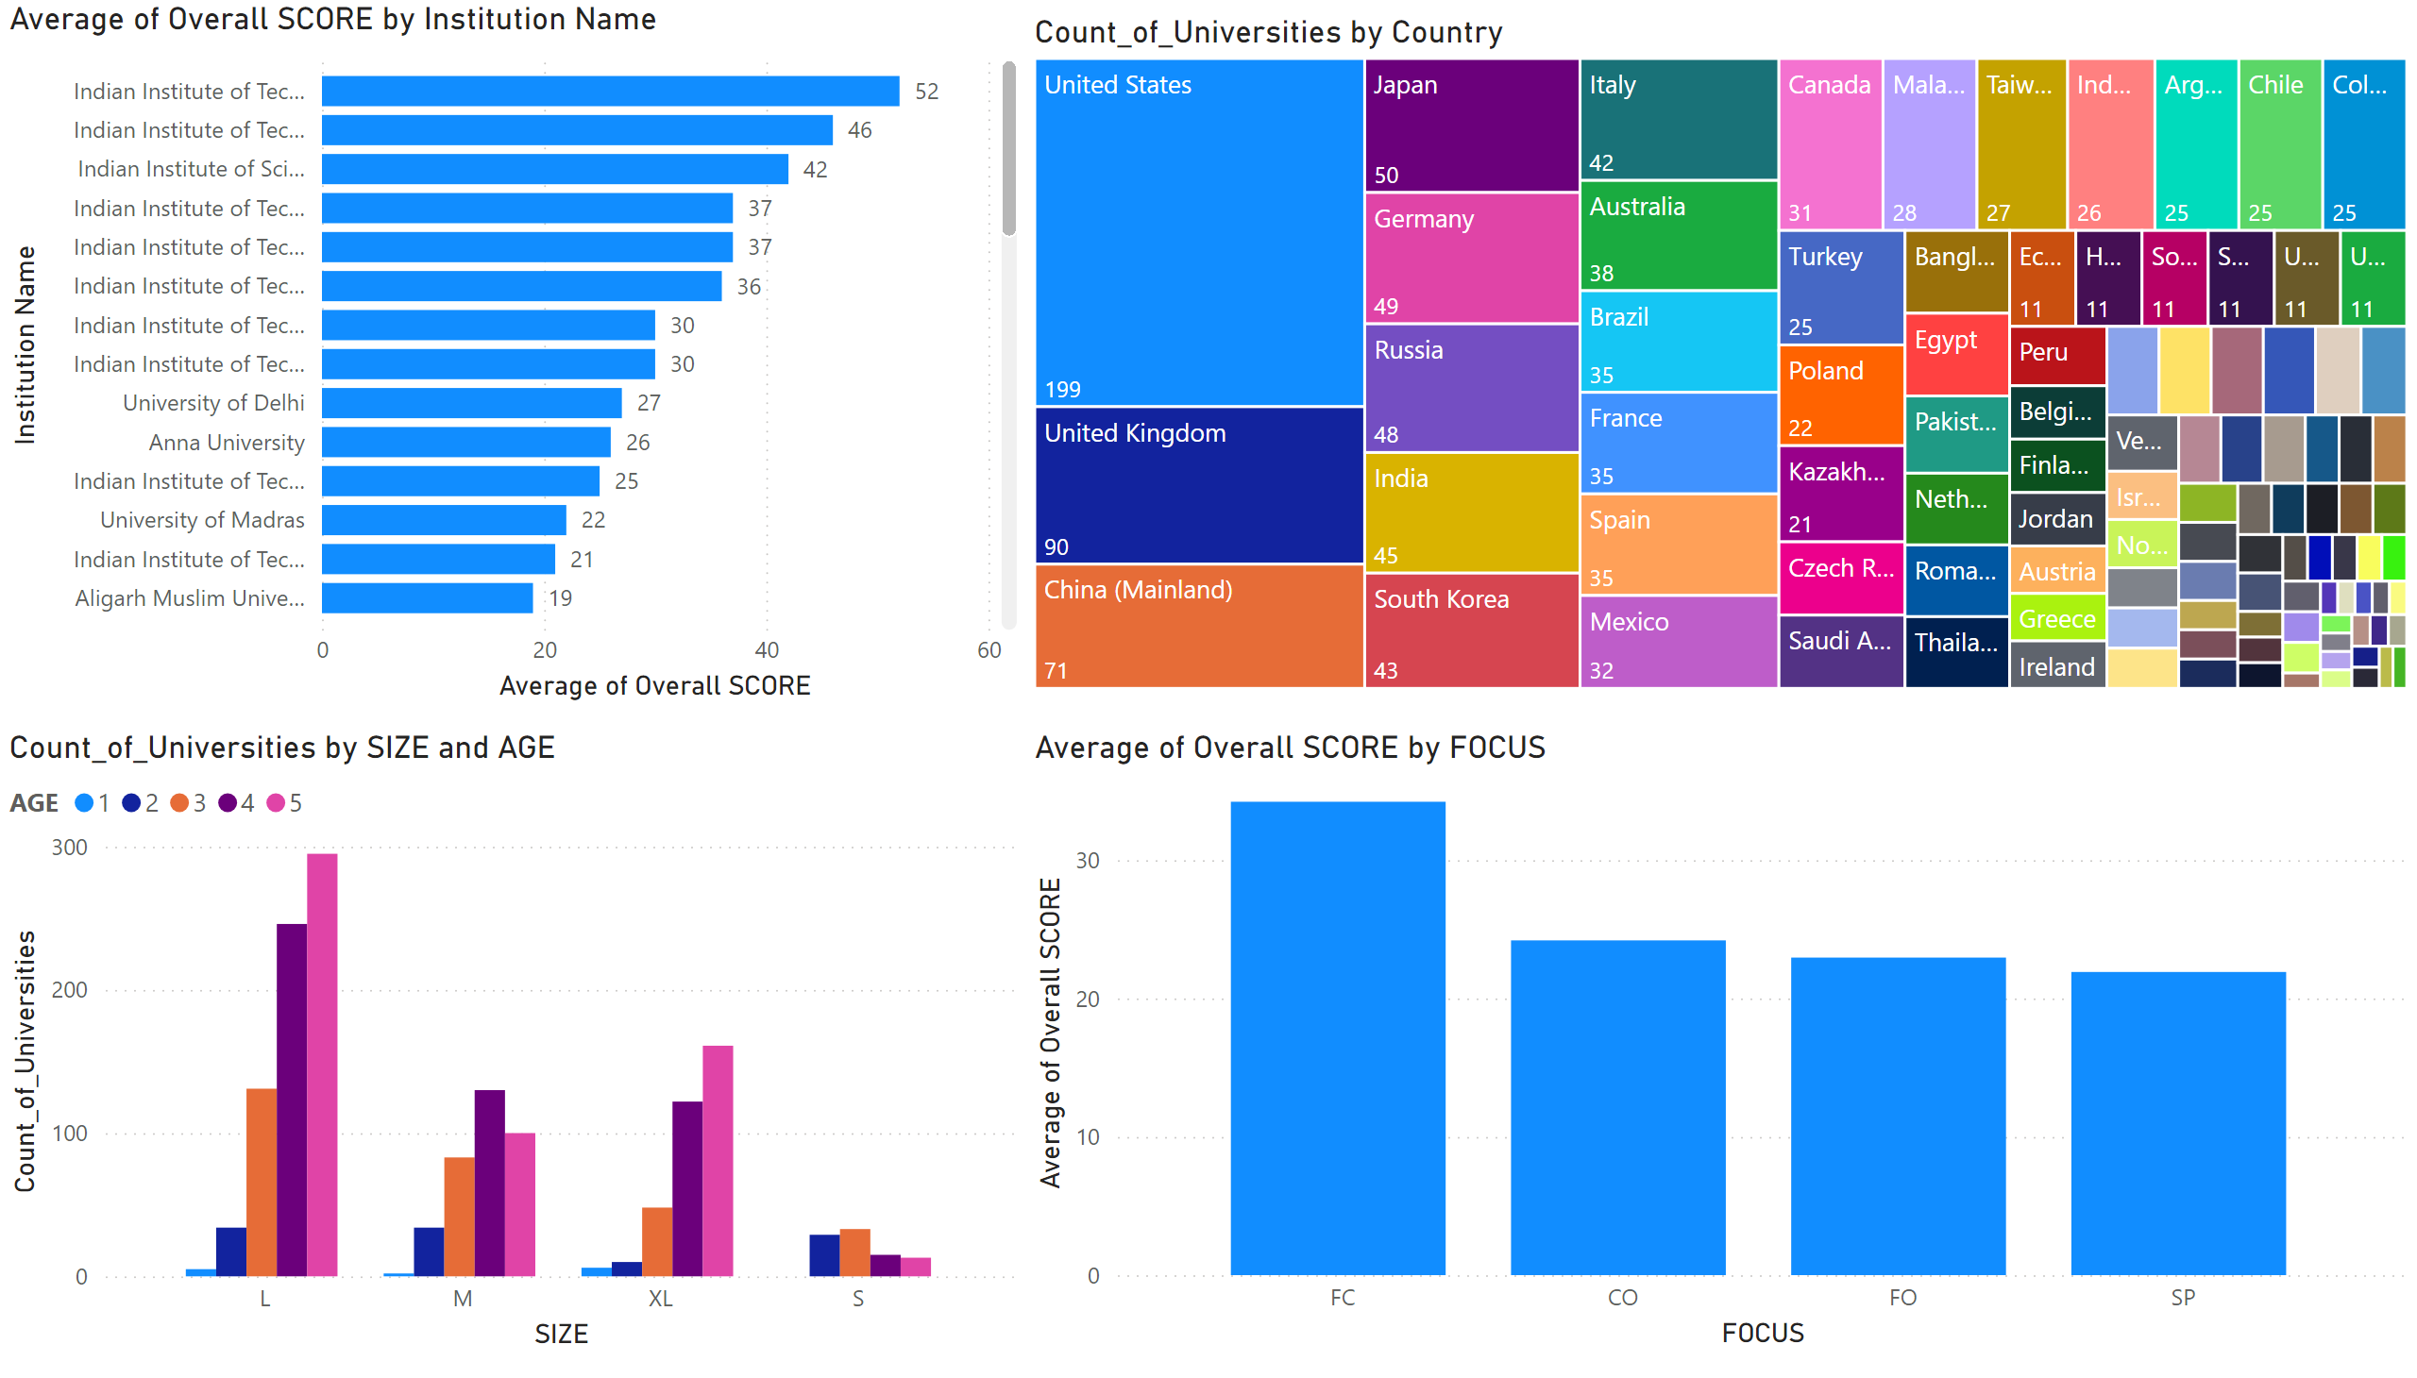
EDA
1st graph shows Average of Universities Overall Score per institution in a country ( Country filter is available for this visual )
2nd graph shows count of universities per country in the research conducted
3rd graph shows count of universities per size ( university student population) and age band shown in different colours where 5 is the oldest
4th graph shows average overall score of universities by focus area
Notes:
barChart
No alt text provided
treemap
No alt text provided
clusteredColumnChart
No alt text provided
columnChart
No alt text provided

Slide 4
Dataset Attachment

